Slide 1

Azure
Extended Zones

Slide 2
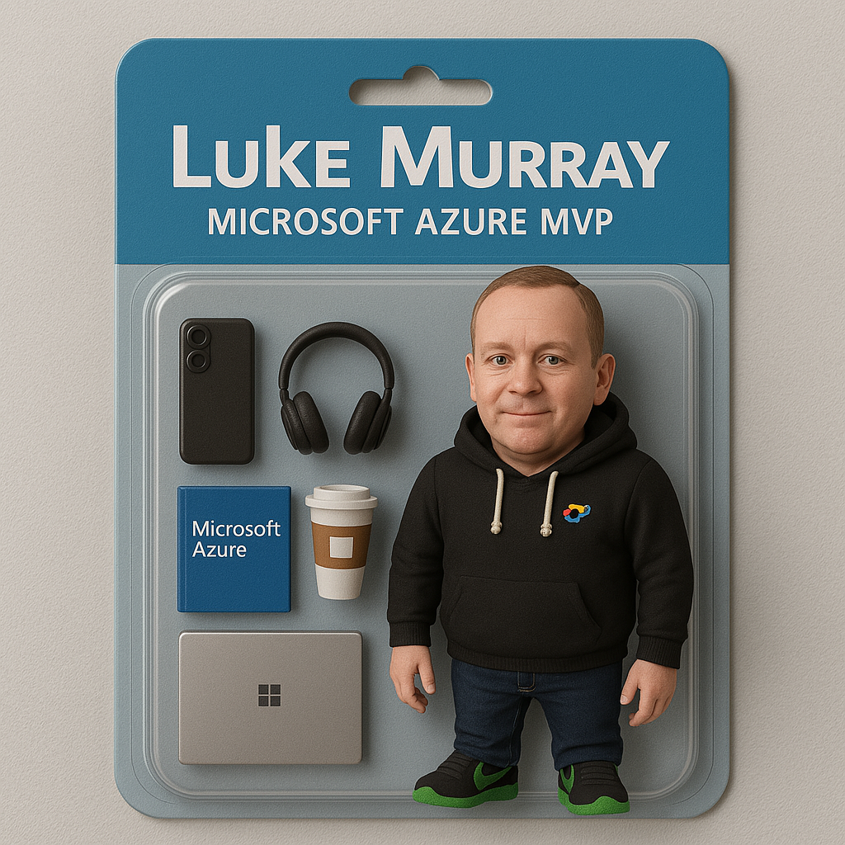
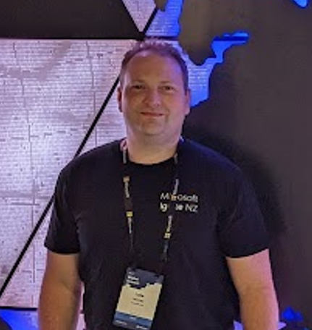


Hello!
Thank you for joining us today
Speaker: Luke Murray
Microsoft Learn Expert and Microsoft Azure MVP, and ISM Service Lead, at HSO from Hamilton, New Zealand.
https://x.com/lukemurraynz
https://www.linkedin.com/in/ljmurray/
https://luke.geek.nz/
https://www.youtube.com/@lukemurraynz

Slide 3
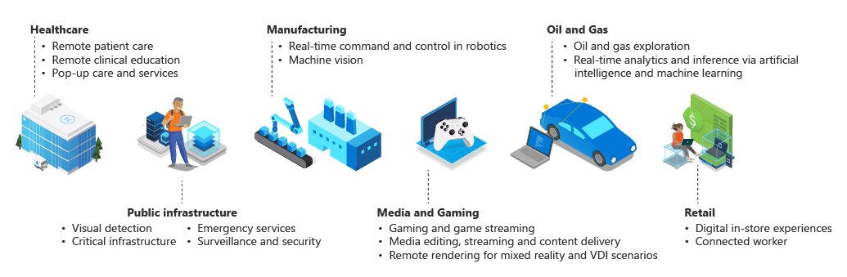

Slide 4
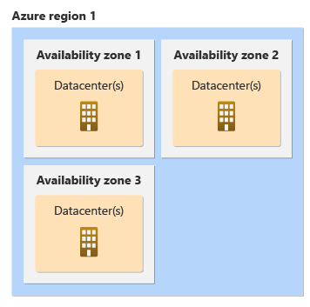
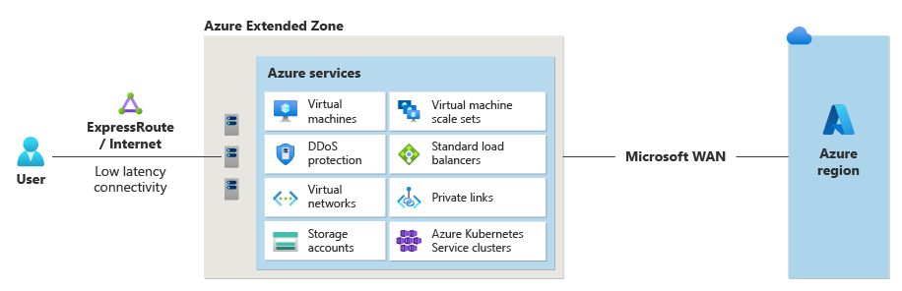
Azure Extended Zone - Perth

